Slide 1
MIS 321
4 Pillars of OOP

Slide 2
Procedural Programming
Program
F1()
x
F2()
Y

Slide 3
Procedural Programming
F1()
F3()
F6()
F5()
F4()
F2()

Slide 4
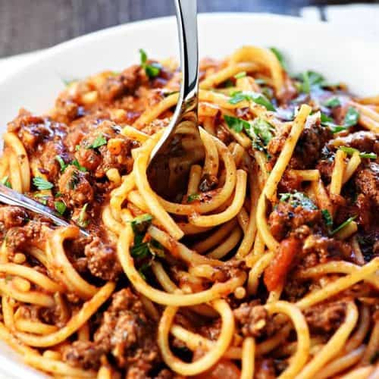
Spaghetti Code

Slide 5
Object Oriented Programming
Program
F1()
x
Methods
Properties
F2()
Y

Slide 6
Example
Person
First Name
Last Name
Birthdate
Email
Talk()
Walk()
SayHello()

Slide 7
Encapsulation
Bundling data and methods that work on that data within a single unit (i.e. the object)
Used to hide the internal representation, or state, of an object from the outside.

Slide 8
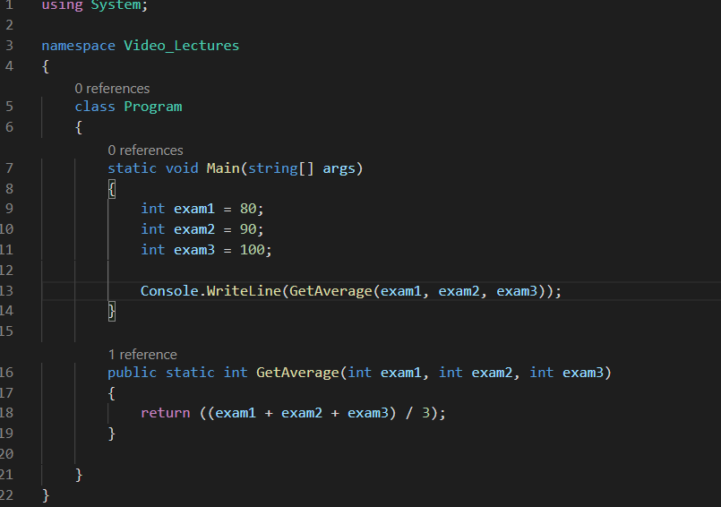
Procedural vs OOP

Slide 9
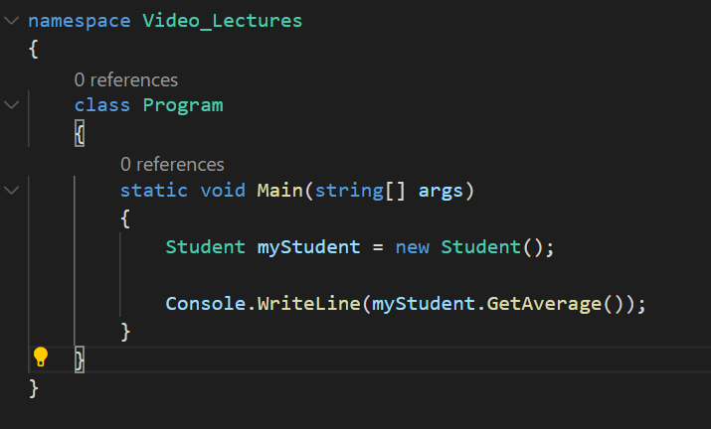
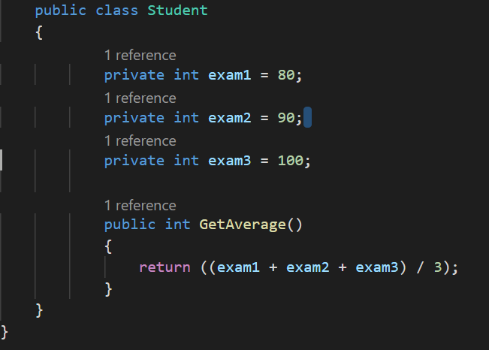
Procedural vs OOP
“The best functions are those with no parameters!” – Robert C. Martin (Uncle Bob)

Slide 10


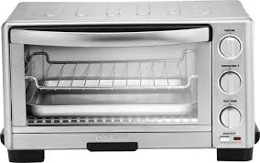
Abstraction
Handle complexity by hiding unnecessary details from the user, enabling the user to implement more complex logic on top of the abstraction without needing to understand the hidden complexity.

Slide 11
Abstraction
Simpler Interface
Reduces the impact of change
Person
-First Name
-Last Name
-Birthdate
-Email
-Talk()
+Walk()
+SayHello()
+SayGoodbye()

Slide 12
Inheritance
Deriving a new class from an existing class forming a hierarchy of classes.
The derived class or subclass inherits methods and properties from the parent or super class.
Intended to help with reuse of existing code with little or no modification.
For example, a TA “is a” person. The TA class could inherited from the Person class forming an “isa” relationship between the two classes.
Derived classes can be treated like the parent class. i.e. we can call all methods from the Person class on an object type of TA.

Slide 13
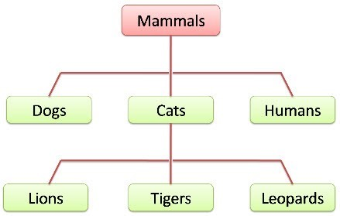
Inheritance

Slide 14
Polymorphism
Poly morphism
Many Form
Literally means many forms. It describes the idea that different classes can be used with the same interface.
Each class can provide its own implementation of the interface.
Allows us to eliminate long if-else structures or case statements

Slide 15
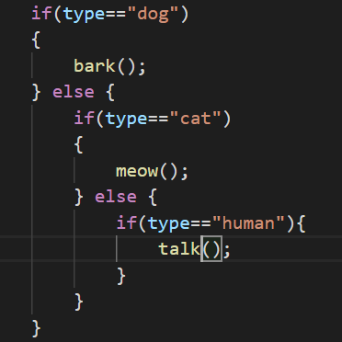
Polymorphism
myMammal.Speak();

Slide 16
Bringing it together
Concept | What is it | Primary Benefit
Encapsulation | Group related data and functions together | Reduce complexity and increase reusability
Abstraction | Hide the details and complexity. Show only essentials. | Reduce complexity and isolate impact of changes.
Inheritance | Deriving a new class from an existing class. | Eliminate redundant code
Polymorphism | Using different classes with the same interface. | Refactor nested if statements and switch statements.

Slide 17
Questions?

